Slide 1


Slide 2
Group Members
Maqsood Ahmed (38186)
Hamza Hassan (38309)
Ab Raheem Ramzan (38132)
Noor Ud Din (37060)
Zakria Abbasi (38000)

Slide 3
Application of Linear Algebra:
Cryptography

Slide 4
Topics Covered :
Encryption
Modular Arithmetic
Decryption

Slide 5
E


Y
N
5


X
Mind
Mapping

Encryption
Z
C
F
J
7
9
T

1
3
2
4

Slide 6

Cryptography
The study of encoding and decoding secret messages is called Cryptography
In the language of cryptography,
Codes are called Ciphers
Uncoded messages are called Plaintext
Coded messages are called Cipher text
The process of converting from plaintext to cipher text is called Enciphering
The reverse process of converting from cipher text to plaintext is called Deciphering.
Harmonics

Slide 7
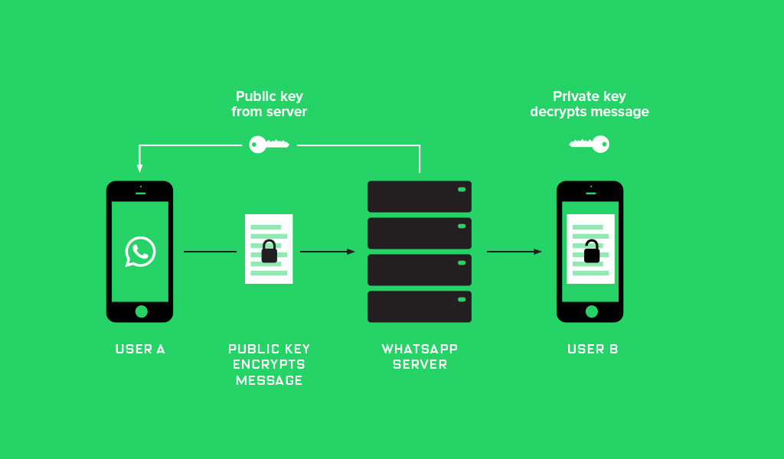
Uses Of Encryption:
Whatsapp End-to-End Encryption
Used by militaries and governments to facilitate secret communication
Harmonics

Slide 8

Different Types of Encryption Methods:
Triple DES
RSA
Blowfish
Twofish
AES
Harmonics

Slide 9
Substitution Cipher
The simplest ciphers, called Substitution Ciphers, are those that replace each letter of the alphabet by a
different letter.
For example, in the substitution cipher
Plain A B C D E F G H I J K L M N O P Q R S T U V W X Y
Cipher D E F G H I J K L M N O P Q R S T U V W X Y Z A B
The plaintext letter A is replaced by D, the plaintext letter B by E, and so forth. With this cipher the plaintext
message.

Slide 10
Disadvantages of Substitution Cipher
They preserve the frequencies of individual letters, making it relatively easy to break the code
by statistical methods.
How to overcome..?
One way to overcome this problem is to divide the plaintext into groups of letters and encipher
the plaintext group by group, rather than one letter at a time.
A system of cryptography in which the plaintext is divided into sets of n letters, each of which is
replaced by a set of n cipher letters, is called a Polygraphic System.

Slide 11
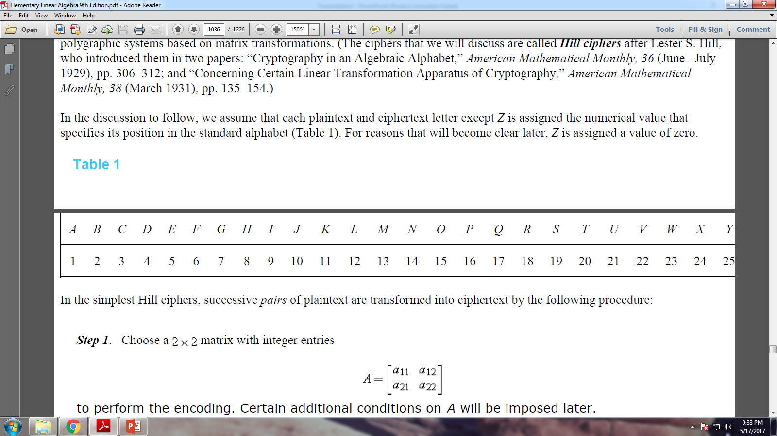
The Hill Cypher
The ciphers that we will discuss are called Hill Ciphers after Lester S. Hill, who introduced them in two papers:
“Cryptography in an Algebraic Alphabet,” American Mathematical Monthly, 36 (June– July 1929), pp. 306–312;
“Concerning Certain Linear Transformation Apparatus of Cryptography,” American Mathematical Monthly,
38 (March 1931), pp. 135–154.
In the discussion to follow, we assume that each plaintext and ciphertext letter except Z is assigned the numerical
value that specifies its position in the standard alphabet (Table 1). For reasons that will become clear later, Z is
assigned a value of zero.
Table 1:
Note Z=0

Slide 12
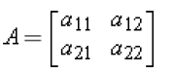
How To Encrypt Text Using Hill Cipher .. ?
Step 1: chose a 2x2 matrix with integer entries.
Step 2 : Divide letters into pairs .
Add a dummy letter if plaintext has odd number of letters .
Replace each plaintext letter by its numerical value.
Step 3 : Convert each plaintext pair into a column vector.
Multiply Matrix A and P.
Step 4 : Convert each cipher text vector into its alphabetic equivalent.

Slide 13
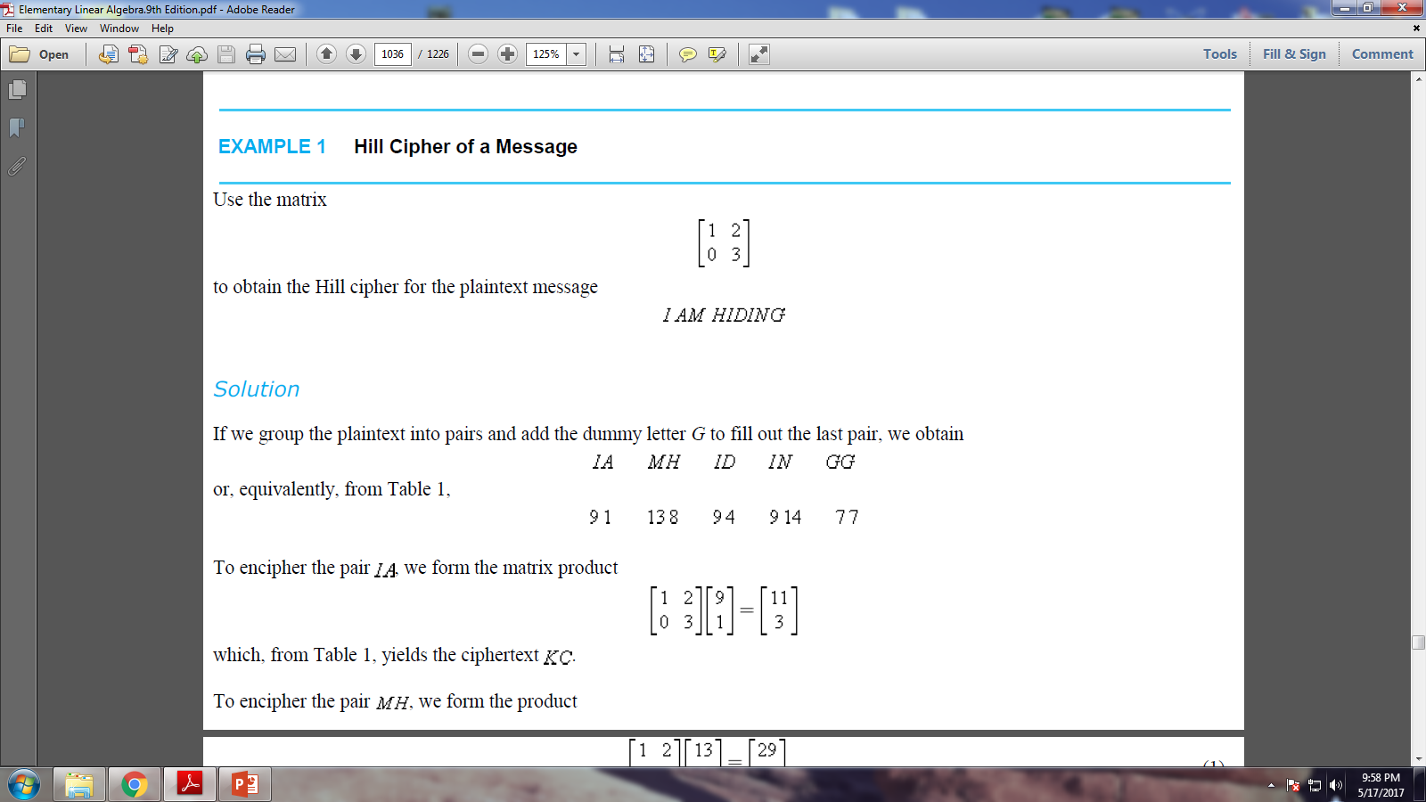
Example 1 : Hill Cypher Of A Message

Slide 14
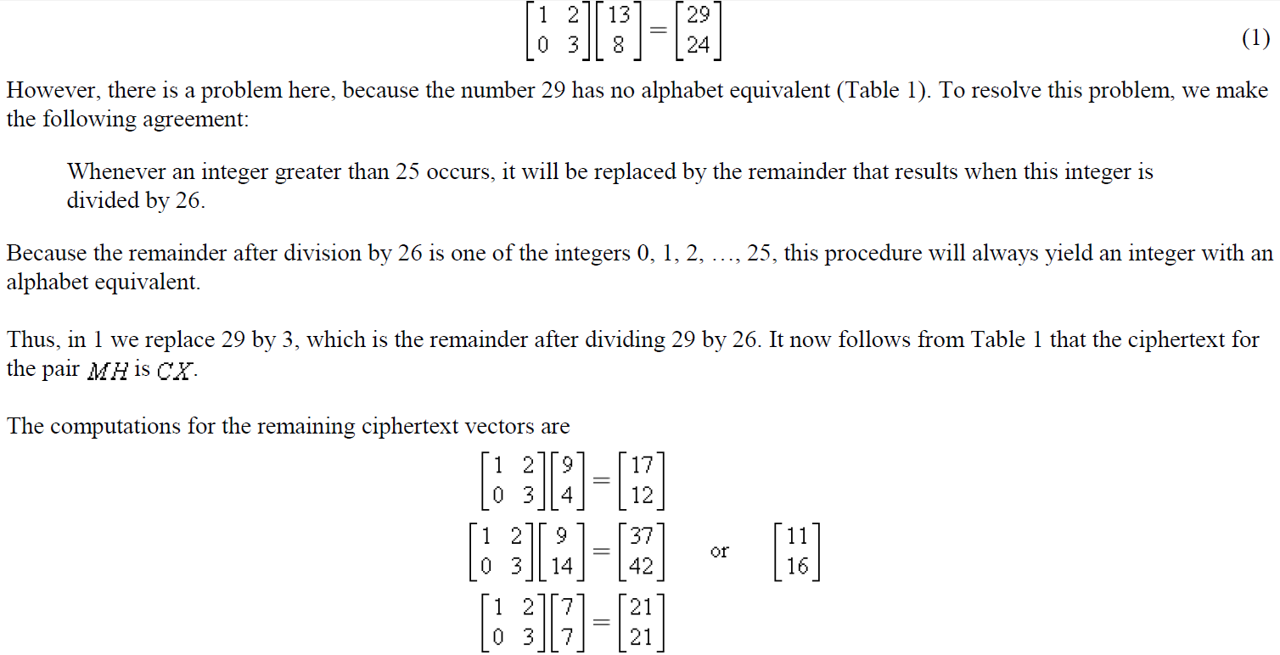

Slide 15
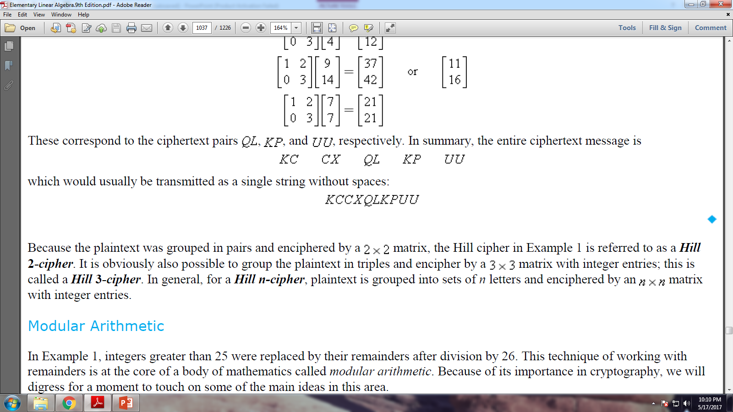

Slide 16
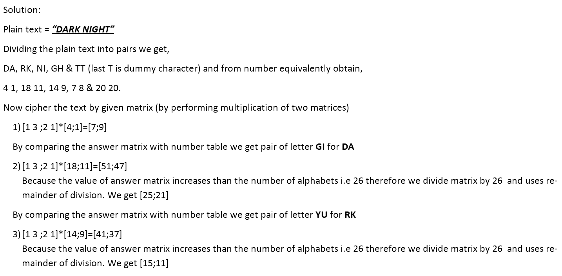
EXERCISE NO 10.15 QUESTION NO 1 (A)

Slide 17
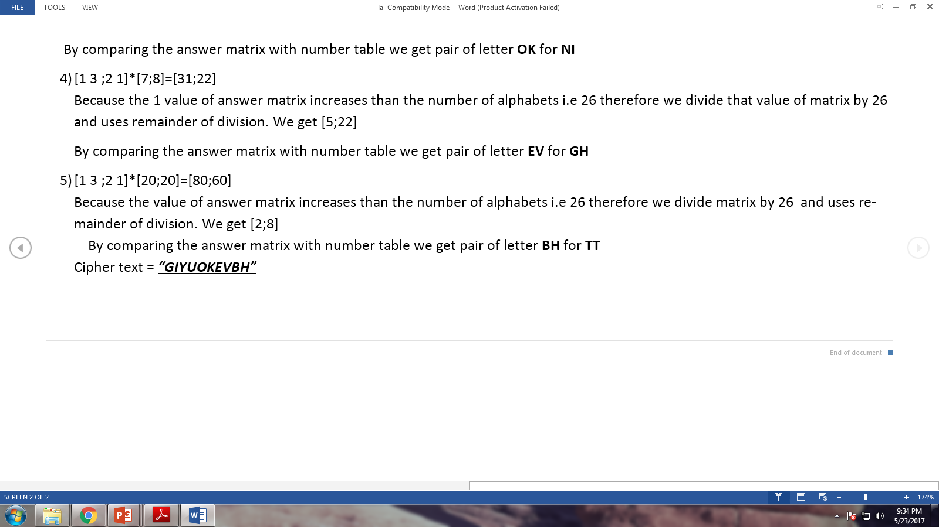

Slide 18
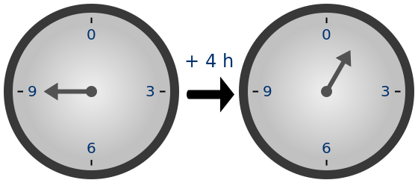
Modular arithematic:
In mathematics, modular arithmetic is a system of arithmetic for integers, where numbers "wrap around" upon reaching a certain value—the modulus (plural moduli). The modern approach to modular arithmetic was developed by Carl Friedrich Gauss in his book Disquisitiones Arithmeticae, published in 1801.
A familiar use of modular arithmetic is in the 12-hour clock, in which the day is divided into two 12-hour periods. If the time is 7:00 now, then 8 hours later it will be 3:00. Usual addition would suggest that the later time should be 7 + 8 = 15, but this is not the answer because clock time "wraps around" every 12 hours; in 12-hour time, there is no "15 o'clock". Likewise, if the clock starts at 12:00 (noon) and 21 hours elapse, then the time will be 9:00 the next day, rather than 33:00. Because the hour number starts over after it reaches 12, this is arithmetic modulo 12. According to the definition below, 12 is congruent not only to 12 itself, but also to 0, so the time called "12:00" could also be called "0:00", since 12 is congruent to 0 modulo 12.

Slide 19
Hill Decipher:
Hill decipher is a process of converting coded/ciphered text into plain text according to the given matrix.
Every useful cipher must have a procedure for decipherment. In the case of a Hill cipher, decipherment uses the inverse (mod 26) of the enciphering matrix. To be precise, if m is a positive integer, then a square matrix A with entries in Z_{m} said to be invertible modulo m if there is a matrix B with entries in Z_{m} such that
AB=BA=I(mod m)
EXAMPLE 7 Decoding a Hill 2-Cipher
Decode the following Hill 2-cipher, which was enciphered by the matrix in Example 6:
GTNKGKDUSK
Solution From Table 1 the numerical equivalent of this ciphertext is
7 20 14 11 7 11 4 21 19 11
To obtain the plaintext pairs, we multiply each ciphertext vector by the inverse of A:
after solving the matrices the alphabet equivalents of these vectors are
ST RI KE NO WW
which yields the message
STRIKE NOW

Slide 20
Q/A
Thank You

